Slide 1
CSE 220
Data Structures
Lecture 08:
Stacks
Anwarul Bashir Shuaib [AWBS]
Lecturer
Department of Computer Science and Engineering
BRAC University

Slide 2
Stacks
A LIFO (Last In, First Out) data structure
Items are added on top of each other
When removing items, the most recently added item is removed first

Slide 3
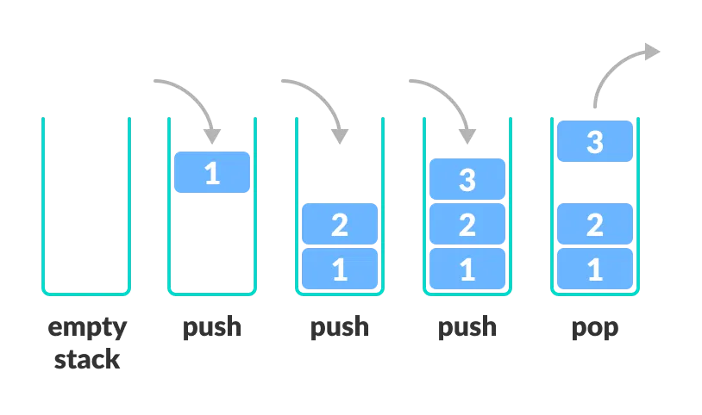
Stacks
A LIFO (Last In, First Out) data structure
Add elements ⇒ push
Remove elements ⇒ pop
  The most recently added element is removed first

Slide 4
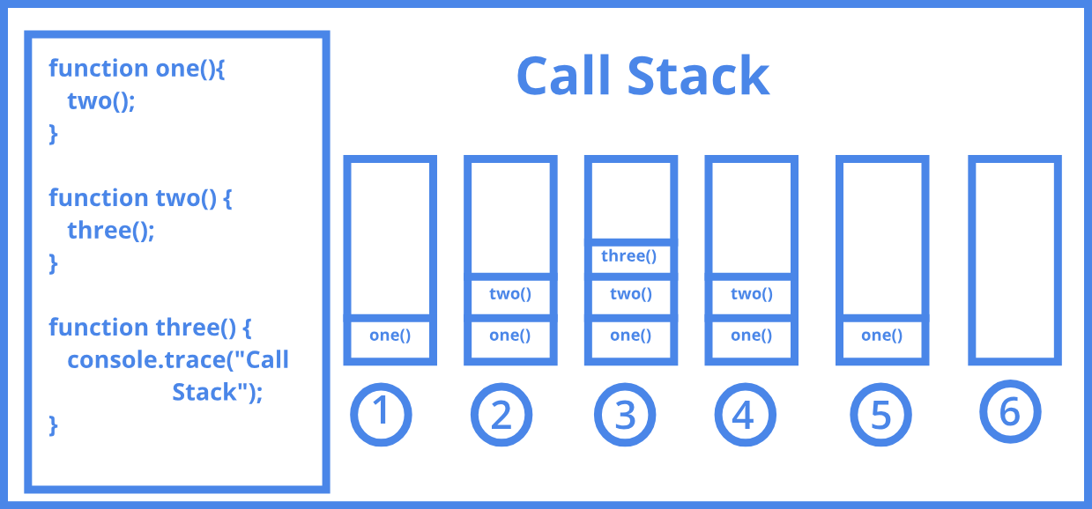
Applications – Function Calls

Slide 5
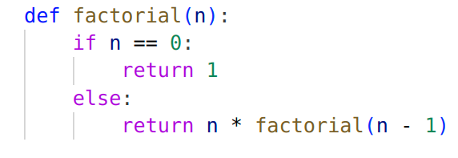
Applications – Function Calls
What would happen if you call factorial(5)?
factorial(5)

Slide 6
Applications – Function Calls
What would happen if you call factorial(5)?
factorial(4)
factorial(5)

Slide 7
Applications – Function Calls
factorial(3)
What would happen if you call factorial(5)?
factorial(4)
factorial(5)

Slide 8
Applications – Function Calls
factorial(2)
factorial(3)
What would happen if you call factorial(5)?
factorial(4)
factorial(5)

Slide 9
Applications – Function Calls
factorial(1)
factorial(2)
factorial(3)
What would happen if you call factorial(5)?
factorial(4)
factorial(5)

Slide 10
Applications – Function Calls
factorial(0)
factorial(1)
factorial(2)
factorial(3)
What would happen if you call factorial(5)?
factorial(4)
factorial(5)

Slide 11
Applications – Function Calls
factorial(0)
1
factorial(1)
factorial(2)
factorial(3)
What would happen if you call factorial(5)?
factorial(4)
factorial(5)

Slide 12
Applications – Function Calls
factorial(1)
1 * 1
factorial(2)
factorial(3)
What would happen if you call factorial(5)?
factorial(4)
factorial(5)

Slide 13
Applications – Function Calls
factorial(2)
2 * 1
factorial(3)
What would happen if you call factorial(5)?
factorial(4)
factorial(5)

Slide 14
Applications – Function Calls
factorial(3)
3 * 2
What would happen if you call factorial(5)?
factorial(4)
factorial(5)

Slide 15
Applications – Function Calls
factorial(4)
What would happen if you call factorial(5)?
4 * 6
factorial(5)

Slide 16
Applications – Function Calls
factorial(5)
What would happen if you call factorial(5)?
5 *24 = 120

Slide 17
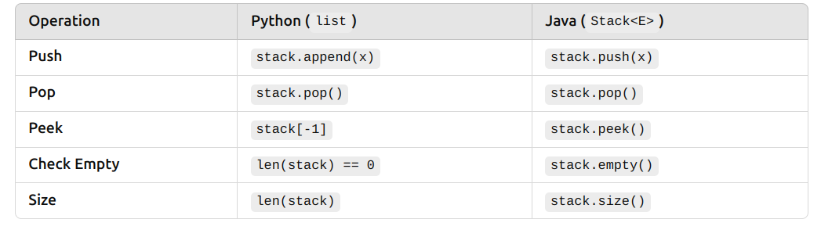
Stack Operations

Slide 18
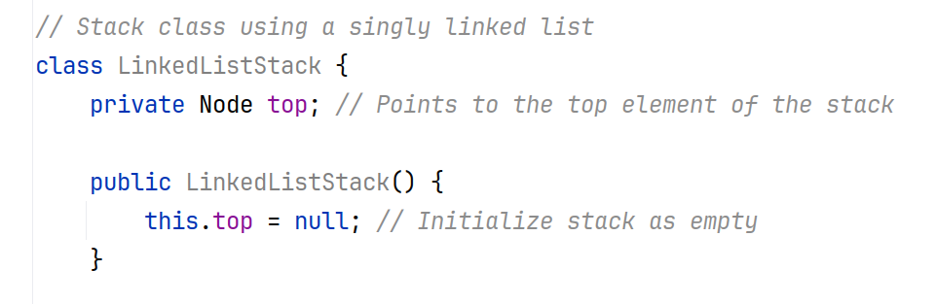
Stack Implementation

Slide 19
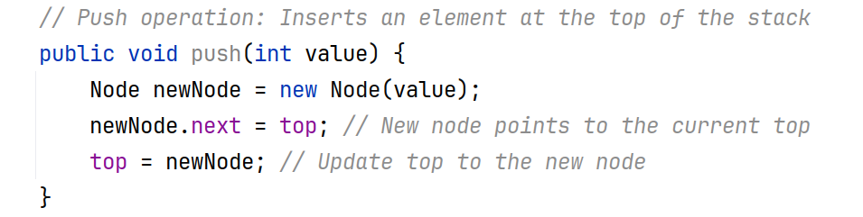
Push
23
top
7
push(12)
10

Slide 20
Push
12
23
top
7
push(12)
10

Slide 21
Push
12
23
top
7
push(12)
10

Slide 22
Push
12
top
23
7
push(12)
10

Slide 23
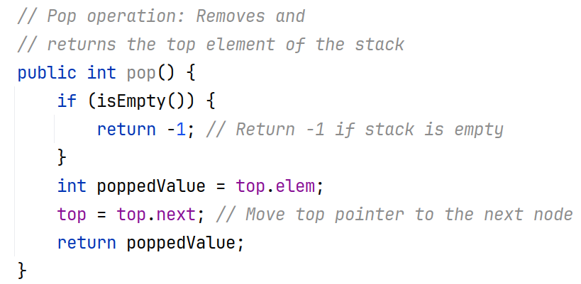
Pop
12
top
23
7
pop()
10

Slide 24
Pop
poppedValue = 12
12
top
23
7
pop()
10

Slide 25
Pop
poppedValue = 12
12
23
top
7
pop()
10

Slide 26
Pop
poppedValue = 12
Garbage collected
23
top
7
pop()
10

Slide 27
Pop
poppedValue = 12
Garbage collected
23
top
7
pop()
10

Slide 28
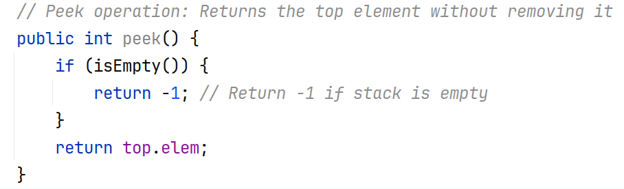
Peek

Slide 29
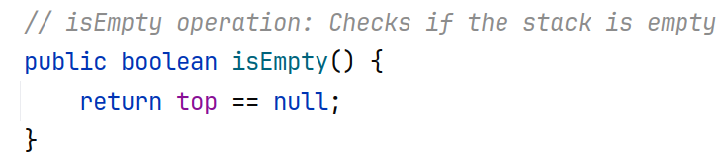
isEmpty

Slide 30
Example: Expression Evaluation
Expression can be written in various ways
For this example, we will focus on postfix notation
2 * 3 + 4 ⇒ Infix notation

Slide 31
Example: Expression Evaluation
Expression can be written in various ways
For this example, we will focus on postfix notation
2 * 3 + 4 ⇒ Infix notation
2 3 * 4 + ⇒ Postfix notation
+ * 2 3 4 ⇒ Prefix notation

Slide 32
Example: Expression Evaluation
Imagine you have a calculator where you first enter the numbers and then specify the operation.
Example: Instead of writing 3 + 4, you write 3 4 +. This means, "Take 3 and 4, then add them."
No parentheses needed: (3 + 4) * 2 becomes 3 4 + 2 *

Slide 33
Postfix Expression
Infix
Postfix
(4 + 5) * 3 - 7
4 5 + 3 * 7 -

Slide 34
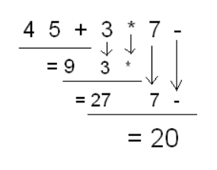
Postfix Expression
Infix
Postfix
(4 + 5) * 3 - 7

Slide 35
Walkthroughs
Expression: 3 4 +
Push 3 → Stack: [3]
Push 4 → Stack: [3, 4]
See +: Pop 4 and 3, add → 3 + 4 = 7
Push 7 back → Stack: [7]
Final result: 7

Slide 36
Walkthroughs
Expression: 5 1 2 + 4 * + 3 -

Slide 37
Walkthroughs
Expression: 5 1 2 + 4 * + 3 -
Push 5 → [5]
Push 1 → [5, 1]
Push 2 → [5, 1, 2]
+ → Pop 2 & 1, compute 1 + 2 = 3, push 3 → [5, 3]
Push 4 → [5, 3, 4]
* → Pop 4 & 3, compute 3 * 4 = 12, push 12 → [5, 12]
+ → Pop 12 & 5, compute 5 + 12 = 17, push 17 → [17]
Push 3 → [17, 3]
- → Pop 3 & 17, compute 17 - 3 = 14, push 14 → [14]
Final result: 14

Slide 38
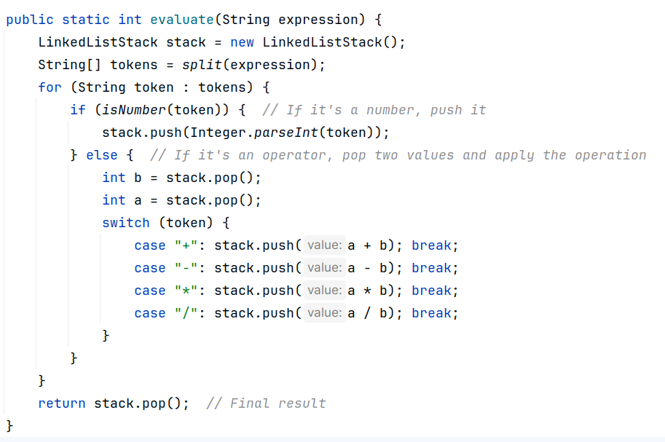
Postfix Evaluation

Slide 39
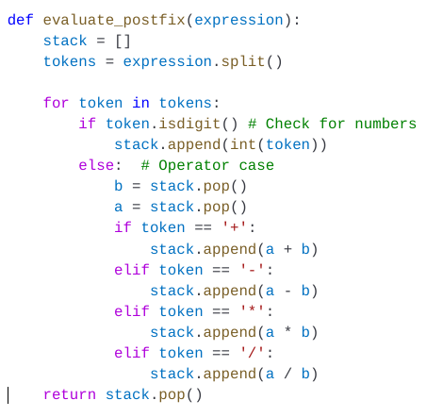
Postfix Evaluation

Slide 40
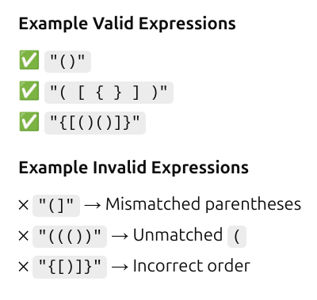
Parenthesis Matching
Parenthesis matching checks if an expression has balanced parentheses, meaning every opening (, {, or [ has a corresponding closing ), }, or ] in the correct order.

Slide 41
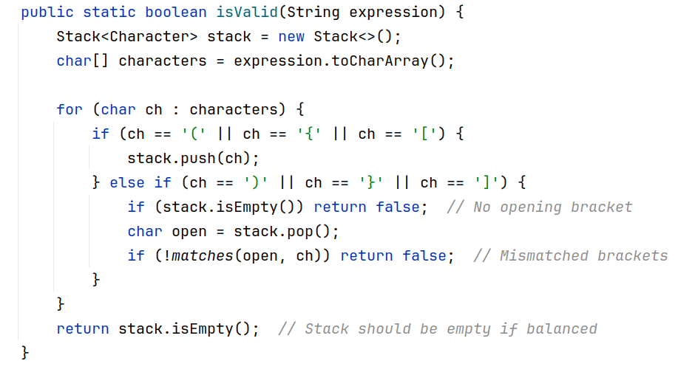
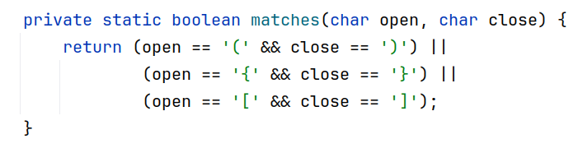
Parenthesis Matching

Slide 42
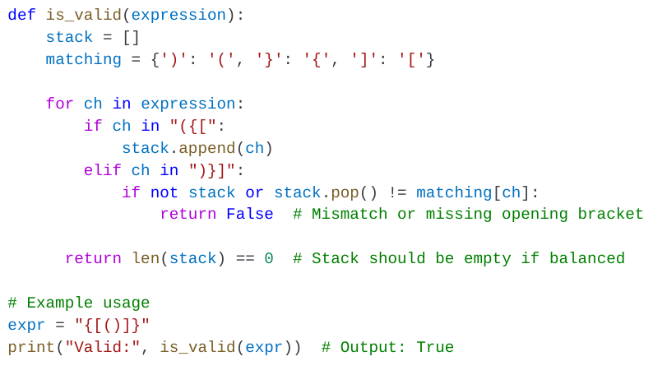
Parenthesis Matching

Slide 43
Midterm solution - Pastebin.com
Postfix parser - Pastebin.com

